Slide 1
Group 3 Project 2
Jance Ng
Jin Min Wood
Adrian Kong

Slide 2
PROBLEM STATEMENT
As a property agency, it is very important to us that we are able to estimate what is the estimated worth of the property. By predicting the worth of a property accurately, we have higher confidence in selling the property and also receiving our well deserved commission. There are many manipulating variables that are affecting the price of a property. We will make use of regression model to estimate the SalePrice of a property and measure how well is our prediction and the actual SalePrice.

Slide 3
DATASET
Number of features: 81; examples below:
Area of the House | Data Column (Feature) | Data Description
Bathroom | bsmt_full_bath | Basement full bathrooms
 | bsmt_half_bath | Basement half bathrooms
 | full_bath | Full bathrooms above grade
 | half_bath | Half baths above grade
Kitchen | kitchen_abvgr | Kitchens above grade
 | kitchen_qual | Kitchen quality
Fireplace | fireplaces | Number of fireplaces
 | fireplace_qu | Fireplace quality
For more information, please refer to: http://jse.amstat.org/v19n3/decock/DataDocumentation.txt)
Notes:
https://www.kaggle.com/competitions/dsi-us-11-project-2-regression-challenge/data

Slide 4
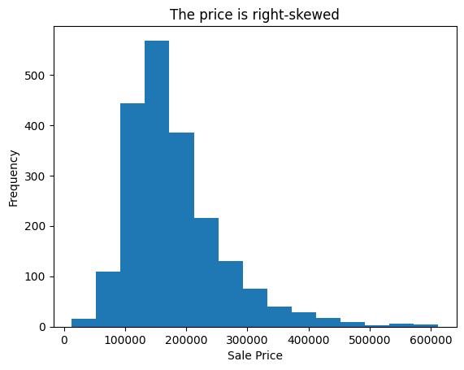
EXPLORATORY VISUALIZATION
Notes:
Explain what is right-skewed
Majority of the price are between 100,000 to 200,000
Very few data with prices from 300,000 onwards
We want a normal distribution is a bell-shaped, symmetrical distribution in which the average, median (which is the 50% mark) and mode (the most frequency) are all equal.

Slide 5
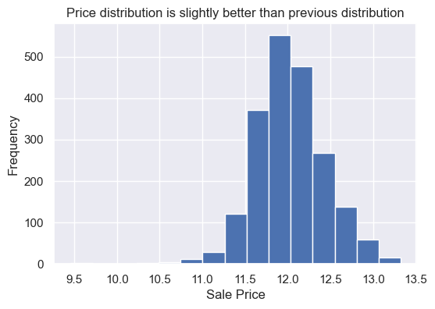
Convert Sale Price to logarithmic scale: log(saleprice)
Notes:
Explain what is log
Hence we do a log transform to make it as “normal” as possible so that the statistical analysis results from this data become more valid.
A log transformation = log(saleprice)

Slide 6
DATA CLEANING - Missing Values
Feature | Remarks
Alley | It can be deduced that there is no alley access.
Bsmt Qual | The missing value count is the same as Bsmt Cond, it can be deduced that there is no basement for these units.
Bsmt Cond | Same as Bsmt Qual.
Garage Type | We can assume these houses have no garage.
Pool QC | We have no other reference, hence we will assume there is no pool.
Notes:
Missing Values
We observed that most of the missing values in the datasets are due to the house missing those specific feature.
Eg, missing value in Alley column signify that the house does not have an alley
There are a few exceptions which we will see in the next two slides

Slide 7
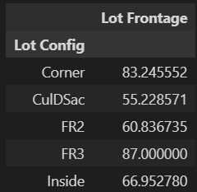
DATA CLEANING - Missing Values - Exception 1
Feature | Remarks
Lot Frontage | We can assume that the unit is an apartment or condominium so it does not have lot frontage. However, looking through the MSSubclass, there is no apartment or condominium. Therefore, we will need to replace the missing values with the mean of the Lot Frontage.
Mean Value
Notes:
For Lot Frontage, we assume that only apartments and condos do not have lot frontage and all houses should have lot frontage. Looking through the MS Subclass which defines the type of the dwelling, we notice that there are no apartments or condo.
We therefore decide to replace the missing values with the mean of the Lot Frontage

Slide 8
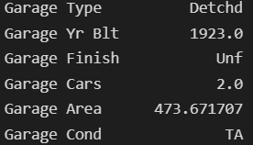
DATA CLEANING - Missing Values - Exception 2
Feature | Remarks
Garage Yr Blt | There is one house with value in under Garage Type but has missing garage year built. We replace missing value under numerical column with the mean value and missing value under categorical column with mode value
Notes:
Further check revealed that it was a detached garage.

Slide 9
PREPROCESSING
Split dataset into numerical and categorical features.
One-hot encode all categorical features.
Merge all numerical and the one-hot encoded categorical features
Split the dataset into 80% train and 20% test
Data | Number of rows | Number of columns
X_train | 1640 | 274
X_test | 411 | 274
y_train | 1640 | 1
y_test | 411 | 1
Notes:
Before we move on to the actual modelling part, we will need to process the data just a little bit further.
We will first need to split the dataset into numerical and categorical features as we will need to convert categorical features into a form that could be ingested in our machine learning model. We do this via one-hot encoding, which is essentially converting each and every category in the features into a column and assigning 0 if the category does not exists, and 1 if the category exists.
Next, we merge all the numerical features and the one-hot encoded categorical features into a dataframe and this dataframe is the one we will be using to build our model.
We split our data frame into 2, by putting 80% of the dataset into what we call the training set and the remaining 20% into the testing set. The training and testing set will allow us to evaluate the performance of our ML model on new unseen data and prevent overfitting.

Slide 10
BASELINE MODEL
Model Used | Linear Regression
Features Used | Lot Area & Overall Quality
R2 score | 0.7142968805431572
Notes:
For a start, instead of including all 274 features in our model, we chose some features which we think would affect the housing the most. Looking through all the features, we decided on lot area and overall quality of the house.
We evaluated our model performance using R2 score. In general, the higher the R-squared, the better the model fits our data. So in this case, we have an r2 score of ~71% so that is not too bad but not great either. Thus, we tried to improve our model by trying out different things in the next few slides.

Slide 11
MODELING PART 1
Steps:
Standardize all features
Fit standardized features to Linear Regression model.
Model Used | Linear Regression
Features Used | Standardized all features
R2 score | -4.6009062687285534e+21
Notes:
The first thing we tried is to model all the features instead of just choosing those which we think will logically affect the prices. We also standardised our features to the same scale as the 274 features have varying scales. For e.g. the variable ‘year built’ ranges between 1800s to the 2000s, while the variable lot area ranges between 0 to 160,000 sqft. Thus, standardisation is needed.
Using this model, we get an r2 score of basically 0%. This is even worse off than our baseline model.

Slide 12
MODELING PART 1 (cont.)
Steps:
Find optimal alpha value
Fit standardized features to Ridge model with optimal alpha value.
Model Used | Ridge
Features Used | Standardized all features
R2 score | 0.8397908717781926
RMSE | 199325.9060718847
Notes:
Next, we tried regularising our model using a technique called Ridge regularisation, but with the same standardisation and also using all features.
After finding the most optimal alpha value for the regularisation, and fitting our training set into the model, we get an r2 score of ~84%. We also calculated the root mean square error, which basically tells us the average distance between the predicted values from the model and the actual values in the dataset. So, the smaller RMSE, the better.
Comparing to our baseline model, even though our R2 score is better, our RMSE is way too big to actually accurately predict the prices.

Slide 13
MODELING PART 1 (cont.)
Steps:
Find optimal alpha value
Fit standardized features to Lasso model with optimal alpha value.
Model Used | Lasso
Features Used | Standardized all features
R2 score | 0.8437015234296557
RMSE | 199147.08628262393
Notes:
Next, we tried out lasso regularisation instead of ridge regularisation.
Our R2 score and RMSE are slightly better than our the previous model with ridge regularisation, but there is still much room for improvement.

Slide 14
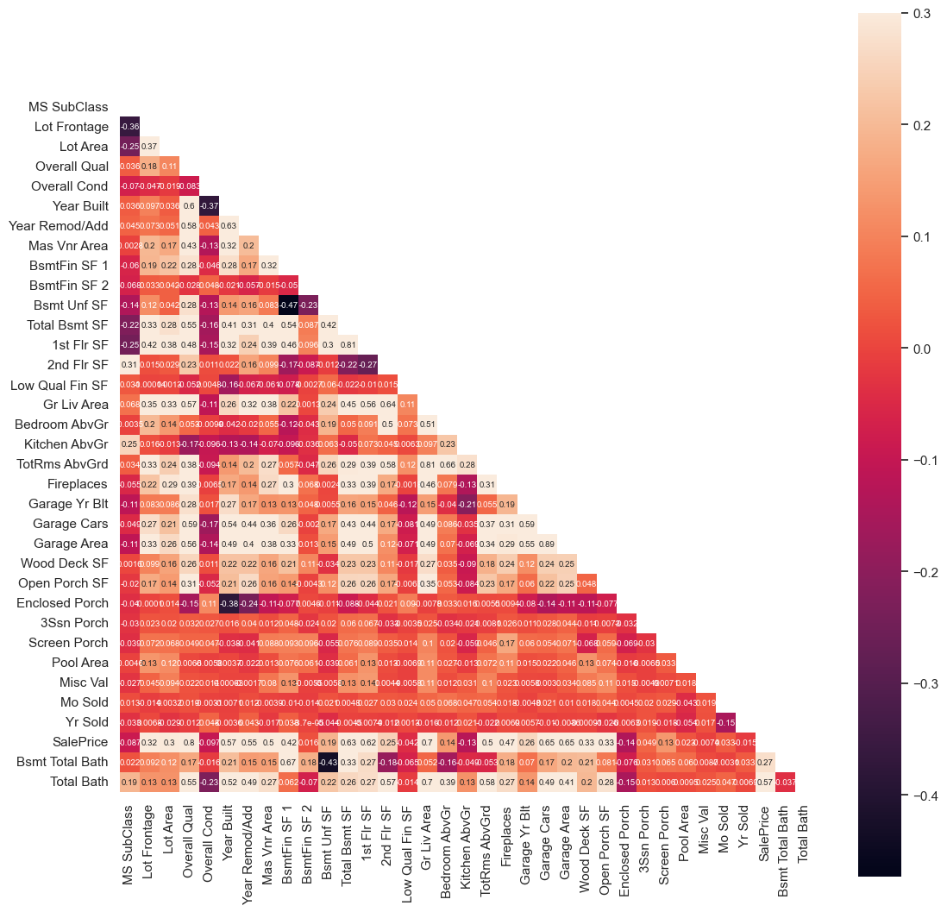
DATA PROCESSING PART 2
Heatmap of correlation of all numerical features.

Slide 15
FEATURE | VIF
Overall Qual | 60.667728
Year Built | 9058.56774
Year Remod/Add | 8910.26204
Mas Vnr Area | 1.85017
Total Bsmt SF | 22.201645
1st Flr SF | 34.998552
Gr Liv Area | 59.79677
TotRms AbvGrd | 55.854408
Garage Cars | 36.763833
Garage Area | 32.589563
SalePrice | 28.860521
Total Bath | 22.967767
These are the features with correlation to SalePrice higher than 0.5
Year Built and Year Remod/Add has high Variance Inflation Factor
Notes:
Vif - variance inflation factor

Slide 16
Final features selected in Part 2 are:
Overall Qual
Mas Vnr Area
Total Bsmt SF
1st Flr SF
Gr Liv Area
TotRms AbvGrd
Garage Cars
Garage Area
Total Bath
Age

Slide 17
MODELING PART 2
Steps:
Standardize all features selected in Data Processing Part 2
Fit standardized features to Linear Regression model.
Model Used | Linear Regression
Features Used | Standardized features selected in Part 2
R2 score | 0.7702069554872076
RMSE | 129467.33485416573

Slide 18
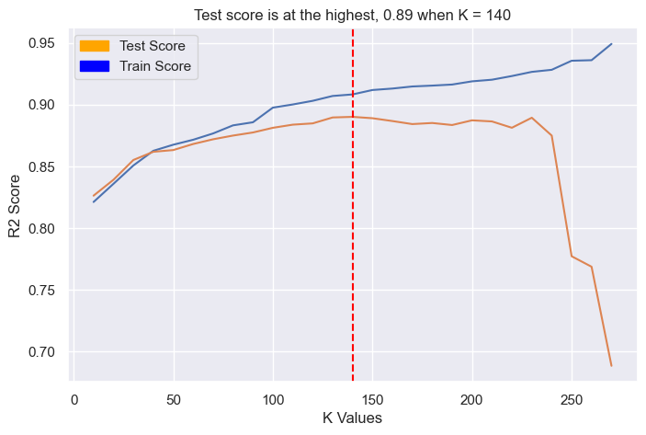
MODELING PART 3 (With SelectKBest)

Slide 19
MODELING PART 3
Steps:
Make use of SelectKBest function to select optimum number of features, K.
Fit and transform the training data with K number features.
Fit transformed data to Linear Regression model.
Model Used | Linear Regression
Features Used | 140 features selected with SelectKBest function
R2 score | 0.890137859811365
RMSE | 23914.714072188213

Slide 20
CONCLUSION
Model | In Section | R2 Score | RMSE
Linear Regression | Baseline Model | 0.7142968805431572 | Not Calculated
Linear Regression | Modeling Part 1 | -4.6009062687285534e+21 | Not Calculated
Ridge | Modeling Part 1 | 0.8397908717781926 | 199,325.9060718847
Lasso | Modeling Part 1 | 0.8437015234296557 | 199,147.08628262393
Linear Regression | Modeling Part 2 | 0.7702069554872076 | 129,467.33485416573
Linear Regression | Modeling Part 3 | 0.890137859811365 | 23,914.714072188213
The method and model in Modeling Part 3 gave us the best R2 score and RMSE. This model will be used to predict house sale price.

Slide 21
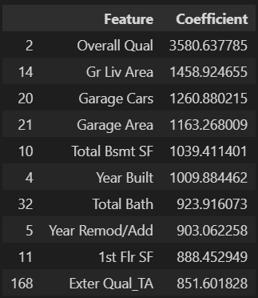
Top 10 Features

